Slide 1

INTRODUCTION TO NETWORKS
HARISH. R
TIFAC-CORE in Cyber Security

Slide 2
Definition – Network
Collection of Nodes through Communication Links
End
Directly used by Users
Computers, Mobile Phones, etc
Intermediate
Indirectly used by Users
Routers, Bridges, etc
Wired
Coaxial
Twisted Pair
Wireless
Infrared
Micro waves
Fiber optic
Radio Waves
Notes:
The Internet is a computer network that interconnects hundreds of millions of computing devices throughout the world. Not too long ago, these computing devices were primarily traditional desktop PCs, Linux workstations, and so-called servers that store and transmit information such as Web pages and e-mail messages. Increasingly, however, nontraditional Internet end systems such as laptops, smartphones, tablets, TVs, gaming consoles, Web cams, automobiles, environmental sensing devices, picture frames, and home electrical and security systems are being connected to the Internet. Indeed, the term computer network is beginning to sound a bit dated, given the many nontraditional devices that are being hooked up to the Internet. In Internet jargon, all of these devices are called hosts or end systems.

Slide 3
Network Topologies
BUS
MESH
RING
STAR
TREE
Notes:
A bus topology orients all the devices on a network along a single cable running in a single direction from one end of the network to the other—which is why it’s sometimes called a “line topology” or “backbone topology.” Data flow on the network also follows the route of the cable, moving in one direction.
Ring topology is where nodes are arranged in a circle (or ring). The data can travel through the ring network in either one direction or both directions, with each device having exactly two neighbors.
The tree topology structure gets its name from how the central node functions as a sort of trunk for the network, with nodes extending outward in a branch-like fashion. However, where each node in a star topology is directly connected to the central hub, a tree topology has a parent-child hierarchy to how the nodes are connected. Those connected to the central hub are connected linearly to other nodes, so two connected nodes only share one mutual connection. Because the tree topology structure is both extremely flexible and scalable, it’s often used for wide area networks to support many spread-out devices.
A mesh topology is an intricate and elaborate structure of point-to-point connections where the nodes are interconnected. Mesh networks can be full or partial mesh. Partial mesh topologies are mostly interconnected, with a few nodes with only two or three connections, while full-mesh topologies are—surprise!—fully interconnected.
A star topology, the most common network topology, is laid out so every node in the network is directly connected to one central hub via coaxial, twisted-pair, or fiber-optic cable. Acting as a server, this central node manages data transmission—as information sent from any node on the network has to pass through the central one to reach its destination—and functions as a repeater, which helps prevent data loss.

Slide 4
Types of Network
Personal Area Network (PAN)
Local Area Network (LAN)
Metropolitan Area Network (MAN)
Wide Area Network (WAN)
Internet
Intranet
Extranet

Slide 5
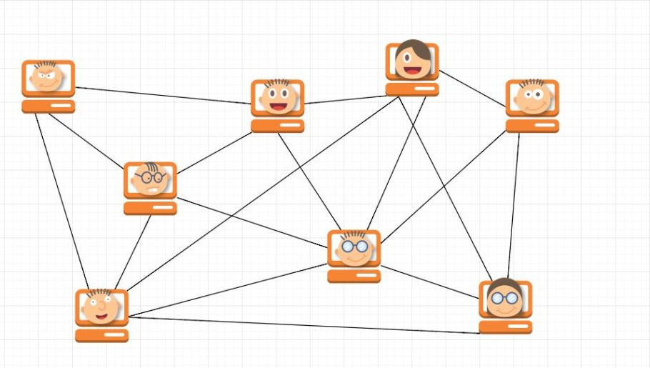
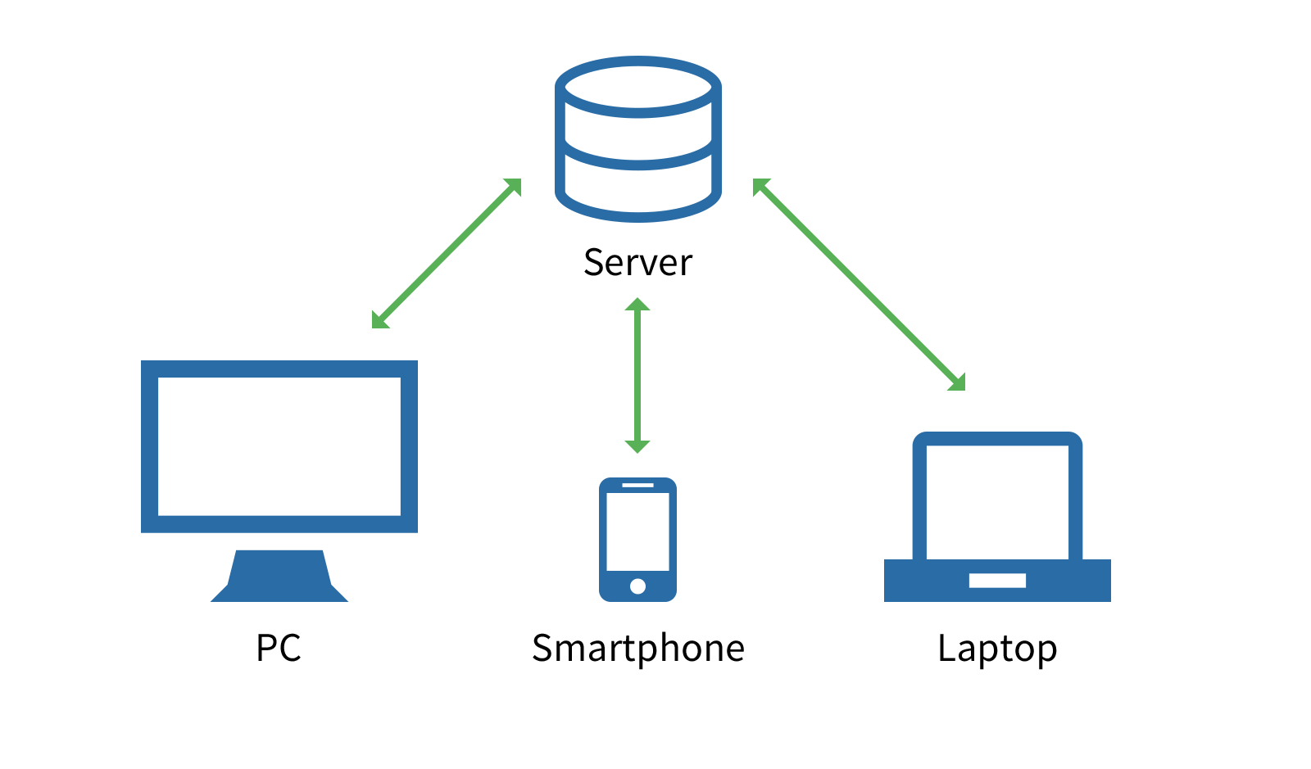
Types of Network Model
Peer to peer Model : E.g Bit Torrents
Server Client Model: E.g E-Mail, Web

Slide 6
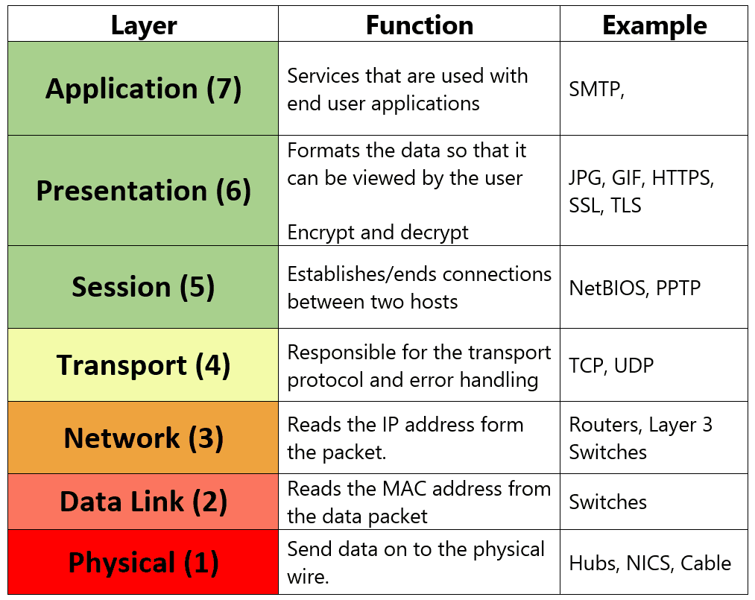
OSI Layer Model

Slide 7
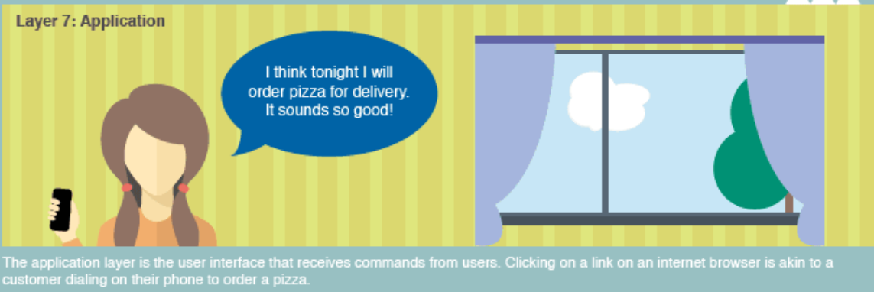
OSI Layer – Pizza Delivery
APPLICATION LAYER

Slide 8
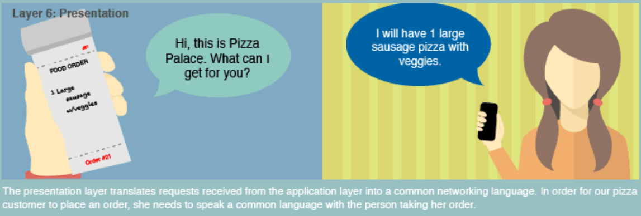
LAYER 6
PRESENTATION LAYER

Slide 9
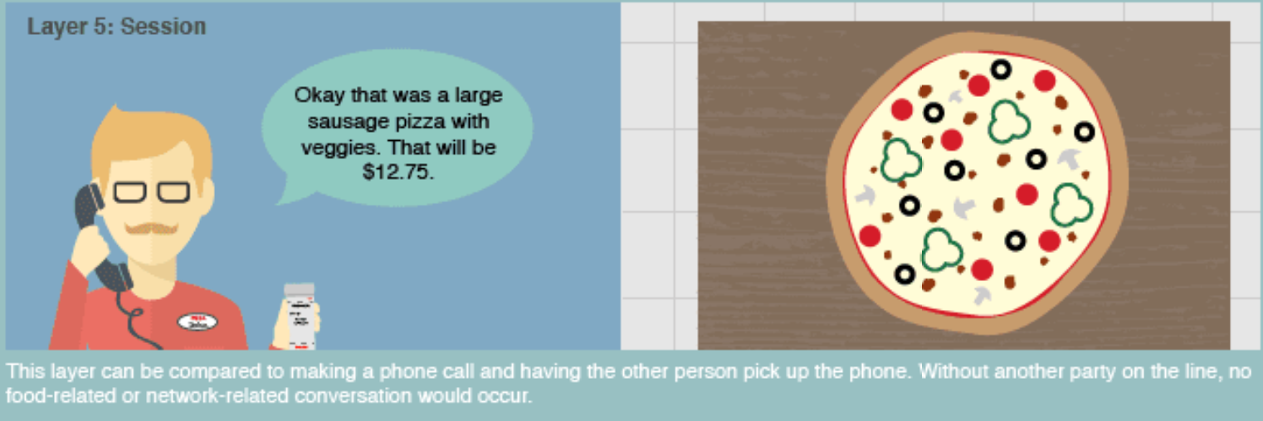
LAYER 5
SESSION LAYER

Slide 10
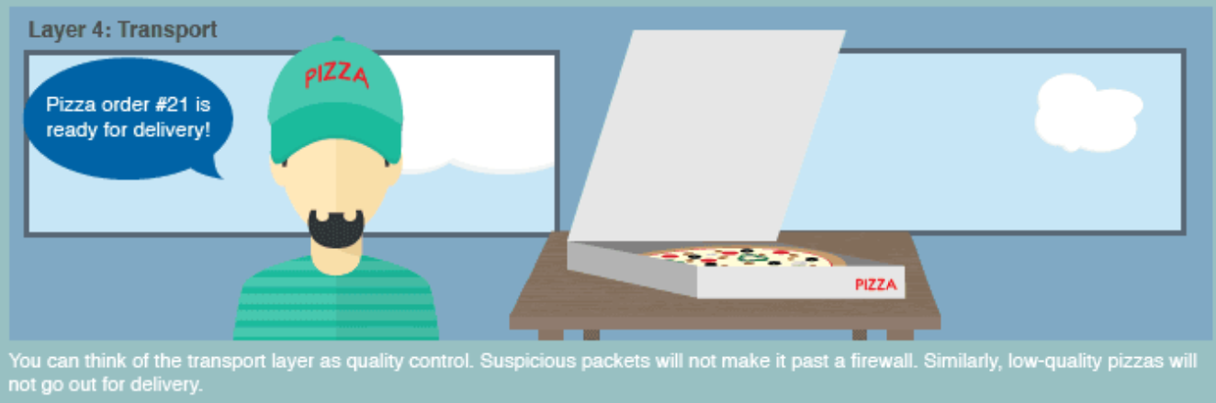
LAYER 4
TRANSPORT LAYER

Slide 11
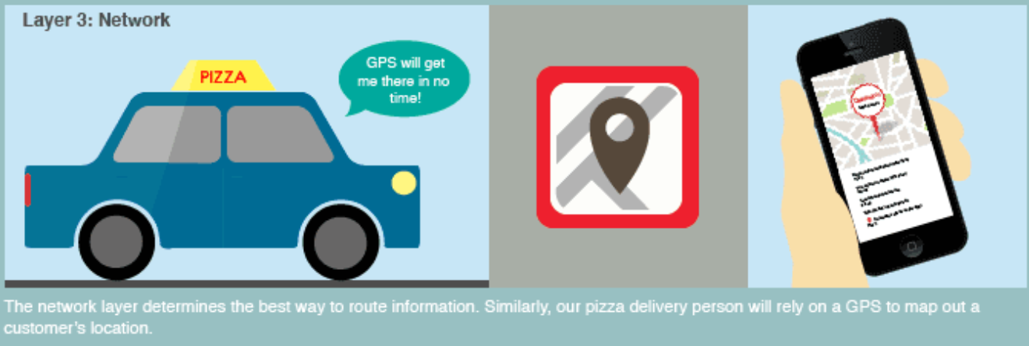
LAYER 3
NETWORK LAYER

Slide 12
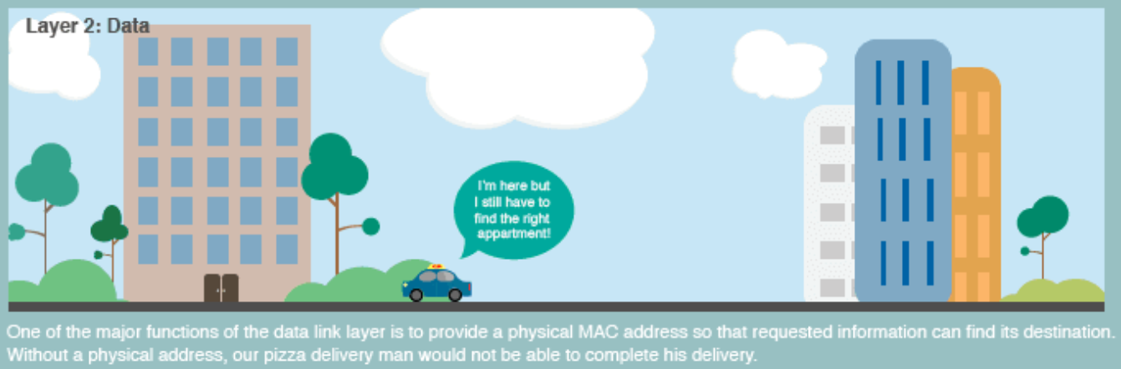
LAYER 2
DATA-LINK LAYER

Slide 13
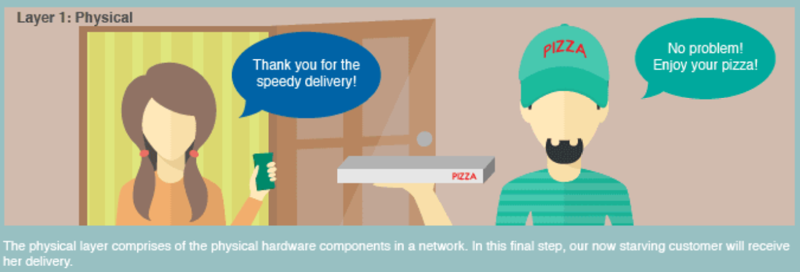
LAYER 1
PHYSICAL LAYER

Slide 14
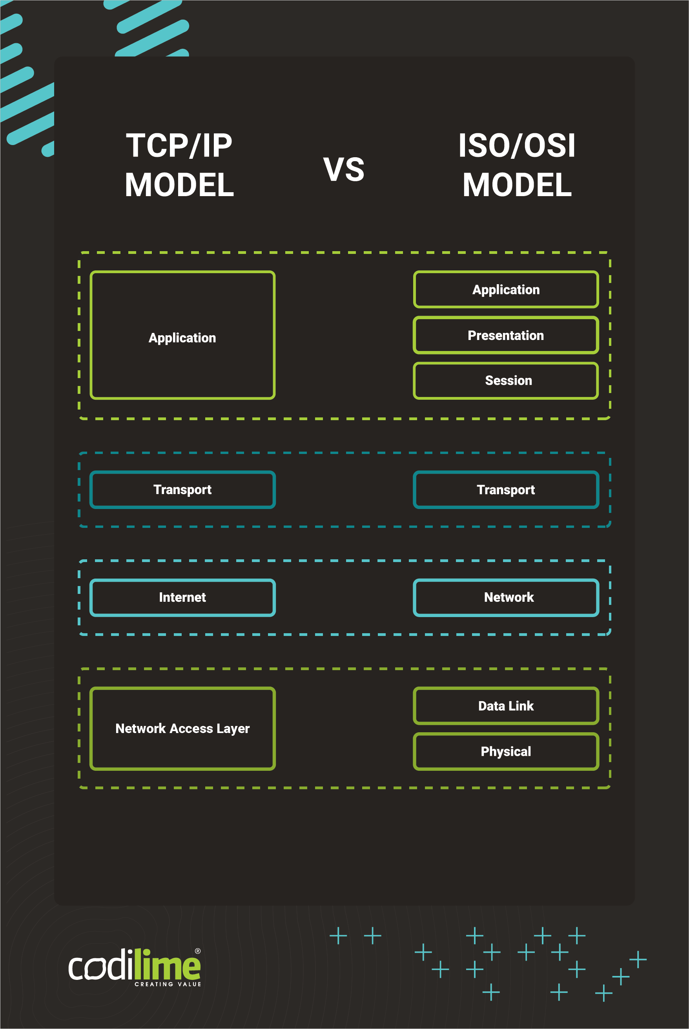
TCP/IP vs OSI Model
4 Layer Model
Support Flexible Architectures
End Node Verification
Replacing a protocol is not easy.

Slide 15
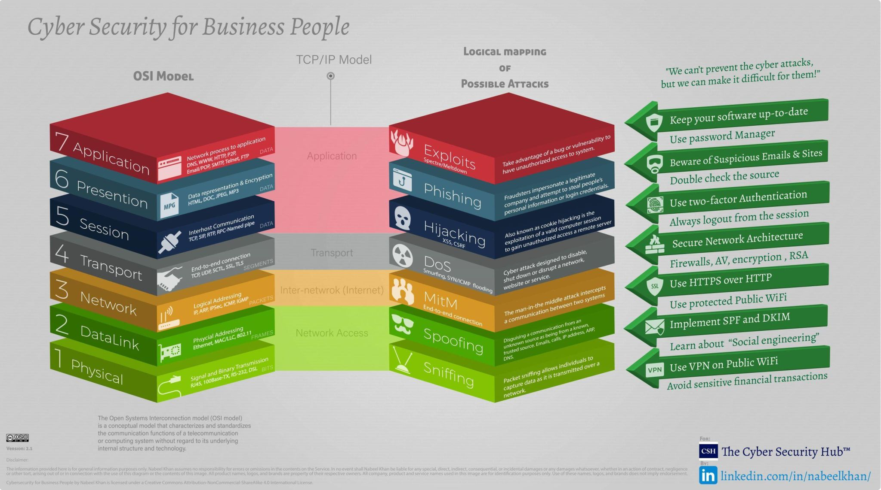

Slide 16
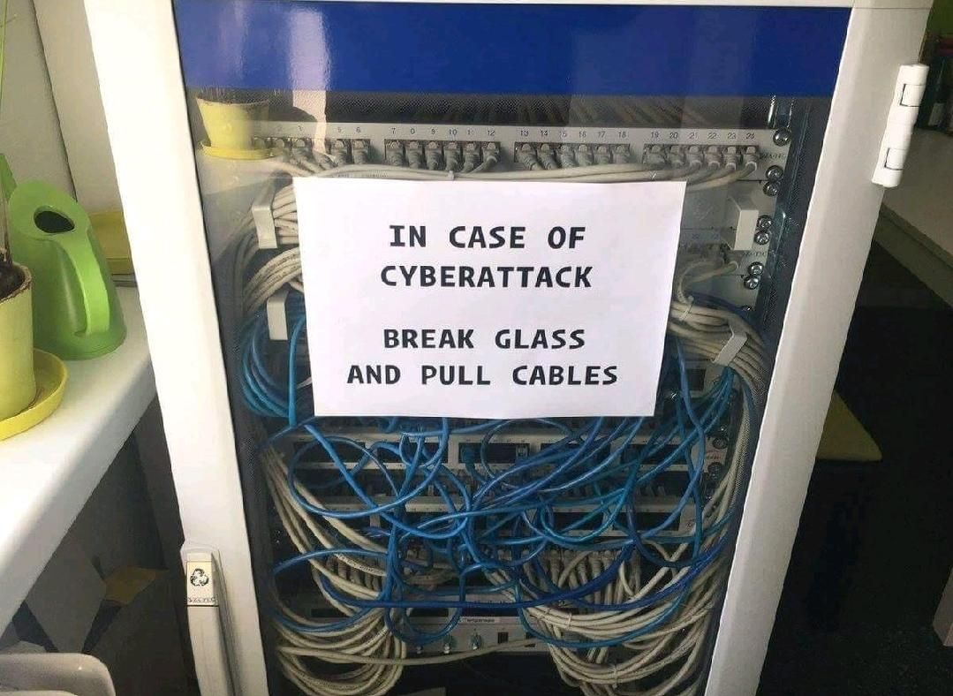

Slide 17
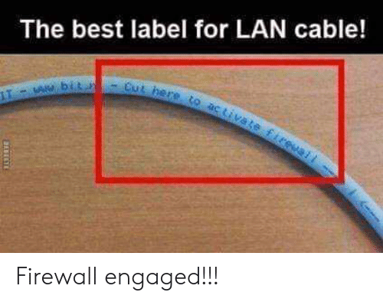

Slide 18


THANK YOU

